Slide 1
Quiz App Project Report

Slide 2
Table of contents
01
02
03
04
Introduction
Screenshot
Code
Function
Intro About Quiz App
Screenshot of Quiz App
Code of Quiz App
Function Used

Slide 3
Introduction
The project “QUIZ APP” is collection of different react questions . A user can access/play the quiz. There will be 10 questions and for each correct answer user will get a 5 credit score. At the end result will be shown that how much you scored and there will be review like Awesome , Oops etc.

Slide 4
Screenshot
Screenshot of Quiz app

Slide 5
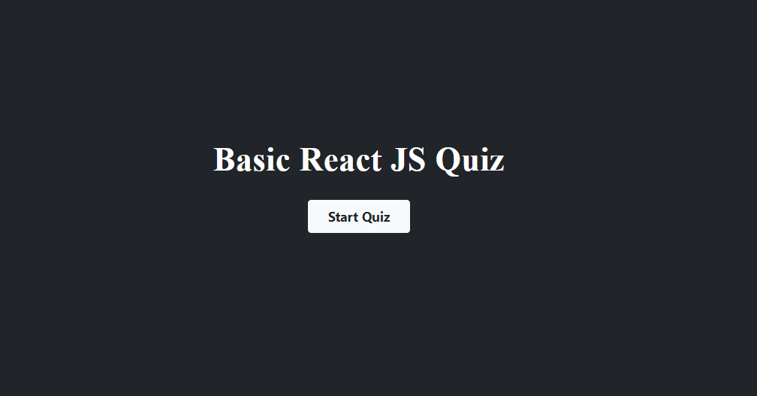

Slide 6
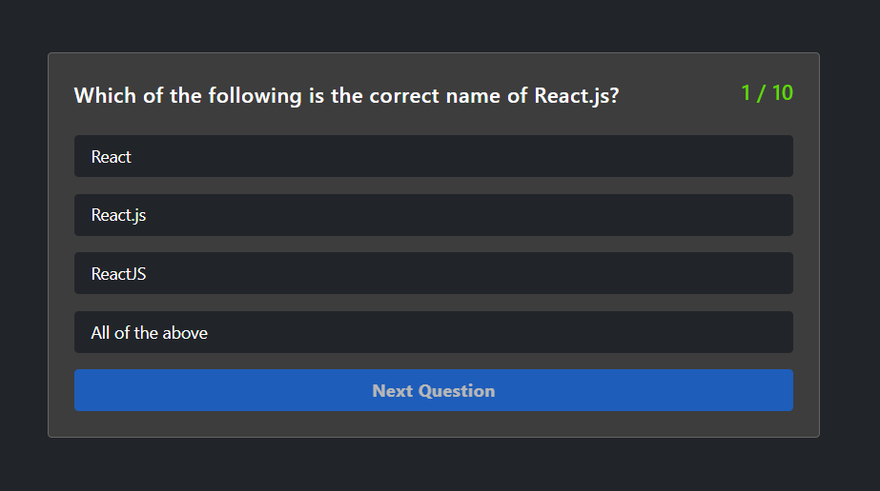
SEO and social marketing goals
Sales
Engagement
Despite being red, Mars is a very cold place
Saturn is the ringed one and a gas giant

Slide 7
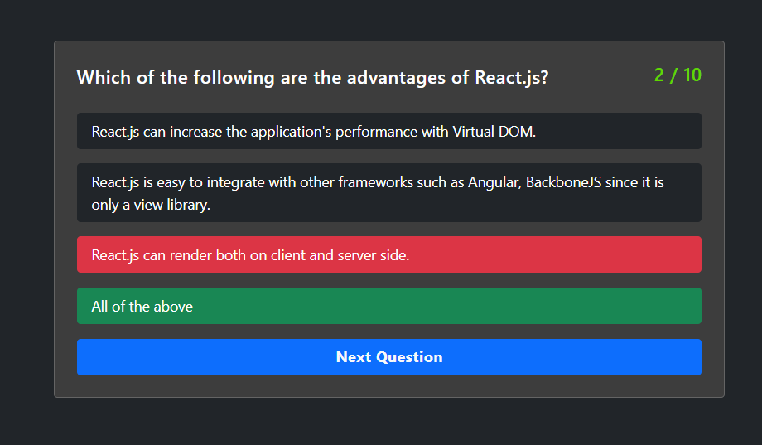

Visits growth
Fans
20%
Saturn is the ringed one
Followers
30%
Mars is actually a cold place
Customers
2020
2022
2024
70%
Venus has a nice name
To modify this graph, click on it, follow the link, change the data and paste the new graph here, replacing this one

Slide 8
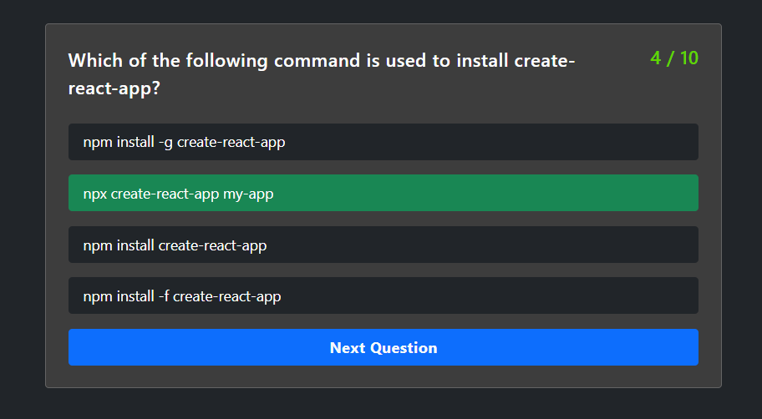
Social marketing
Outreach
Visits
Impressions
Mars is actually very cold
Venus has a beautiful name
Saturn is the ringed one
Sales
Conversion
Clicks
It was named after a god
Neptune is the farthest planet
Jupiter is a gas giant too

Slide 9
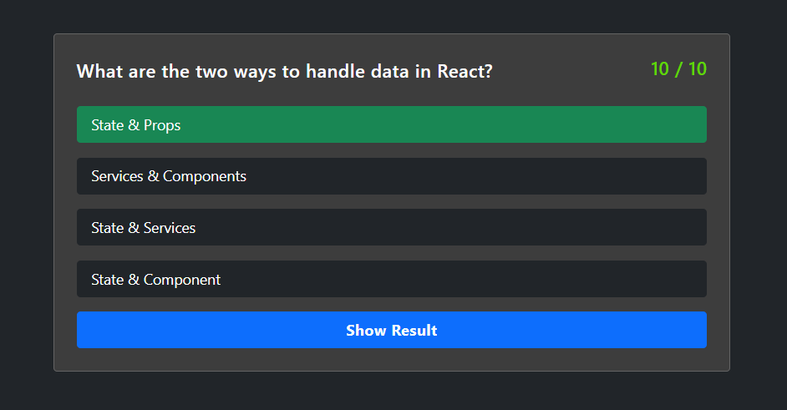
—SOMEONE FAMOUS
«This is a quote, words full of wisdom that someone important said and can make the reader get inspired.»

Slide 10
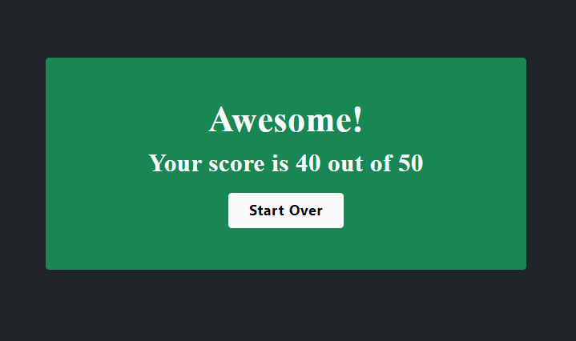
Audience demographics
Greenland
Asia
Mars is actually a cold place
Saturn is the ringed one
America
Africa
Venus has a nice name
Jupiter is the biggest planet

Slide 11
Code
REACT Code

Slide 12
App.js

Slide 13
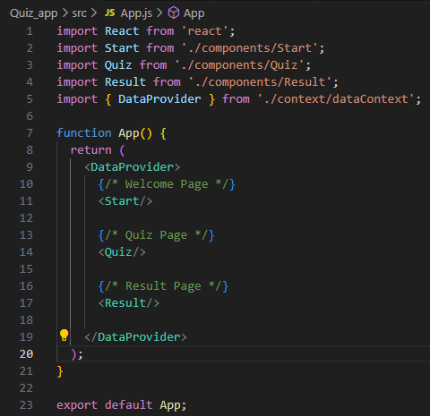
4,333,000,000
Big numbers catch your audience’s attention

Slide 14
Start.js

Slide 15
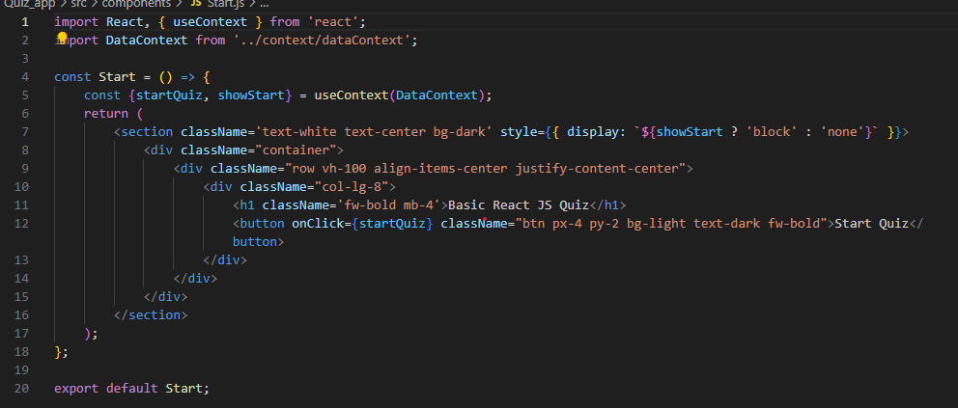
Platform outreach
50%
75%
25%
Conversion
Referral
Clicks
Venus has a nice name
Mars is actually a cold place
Jupiter is the biggest planet

Slide 16
Quiz.js

Slide 17
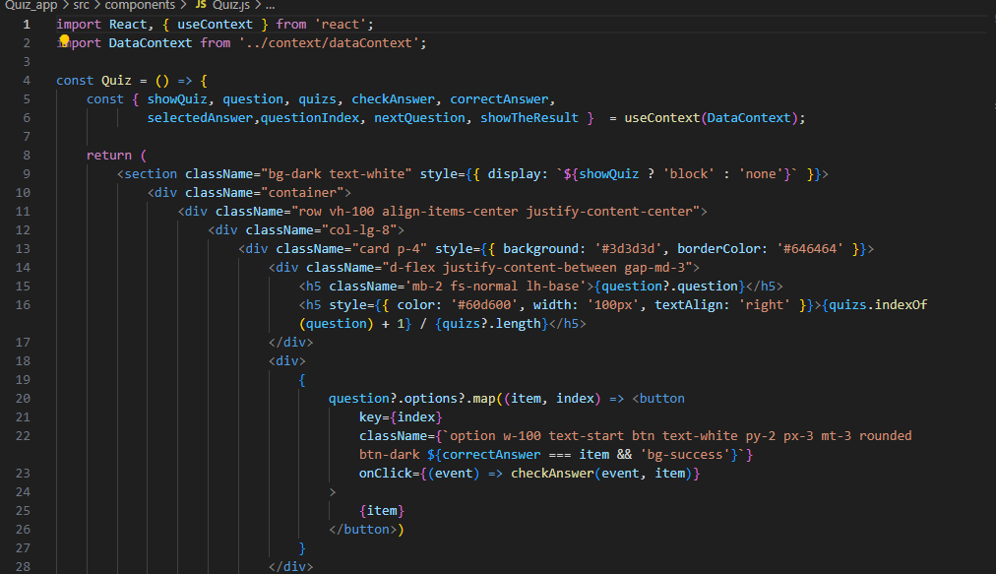
Origin of traffic
Age 36+
20%
Saturn is the ringed one
Age 16-35
30%
Mars is actually a cold place
Age 5-15
70%
Venus has a nice name

Slide 18
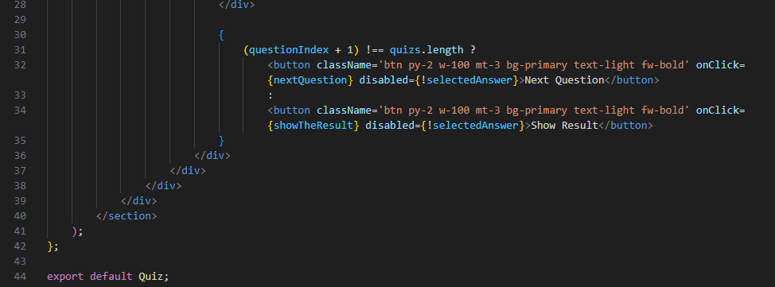
Content distribution
Apps
Social media
Venus has a nice name
Mars is actually a cold place
SMS
Email
Jupiter is the biggest planet
Saturn is the ringed one

Slide 19
Result.js

Slide 20
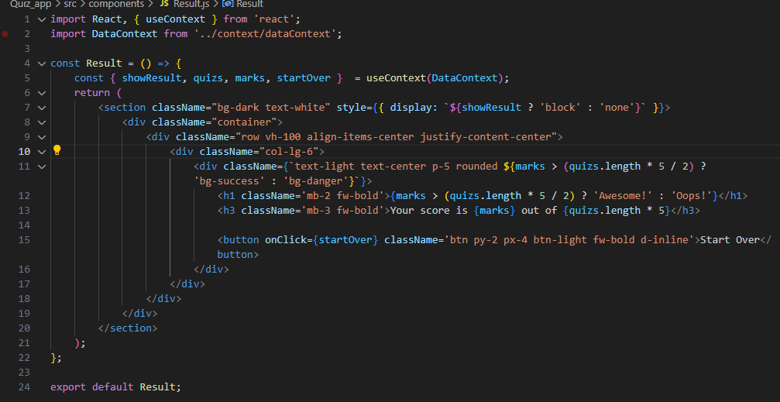
Direct traffic vs referral
80%
20%
Direct
Referral
Mars is actually a cold place
Neptune is the farthest planet

Slide 21
Data Context.js

Slide 22
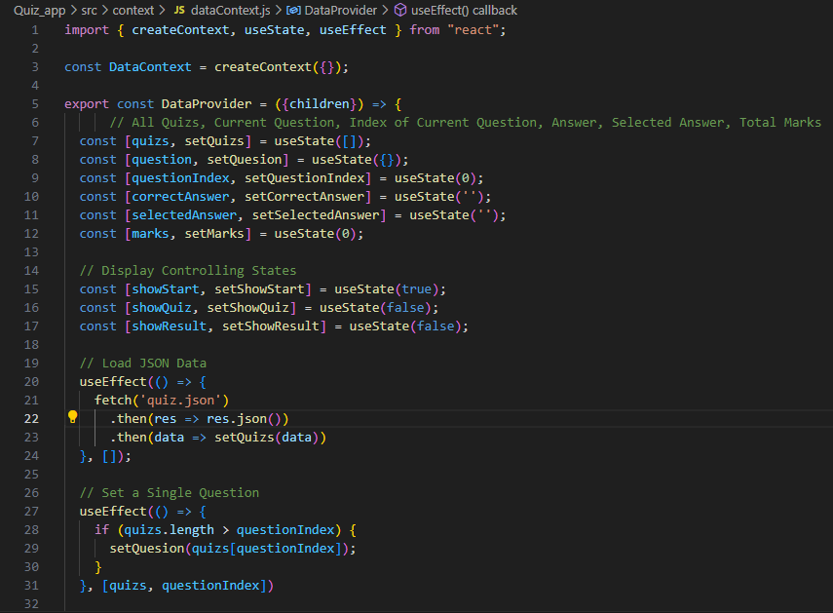
333,000
1h 37m 23s
386,000
unique visitors
average visit duration
clicks per visit

Slide 23
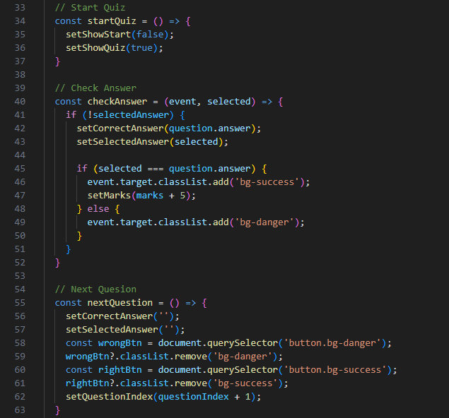
Device optimization
Adaptive content
Mars is actually a very cold place
Screen size
Venus has a very nice name
Flexible structure
Jupiter is the biggest planet

Slide 24
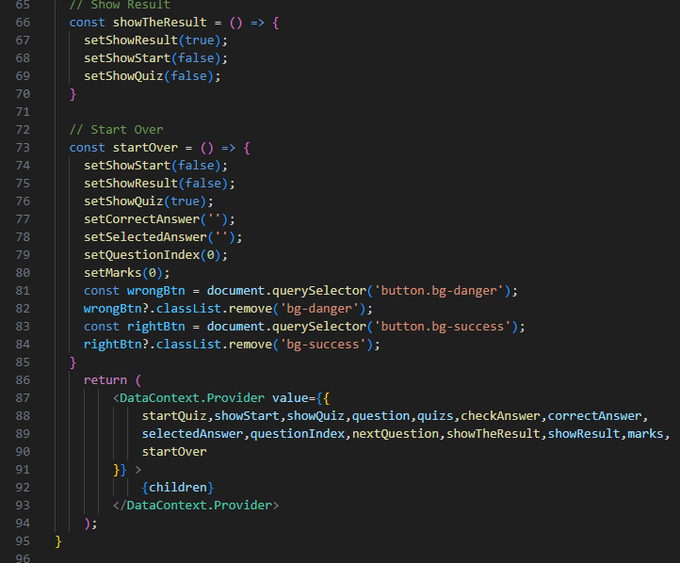
Our team
Jackie Stern
Beth Jenkins
Gloria Cooper
Here you can talk about this person
Here you can talk about this person
Here you can talk about this person

Slide 25
Function used

Slide 26
Function Used
1. In start.js
<button onClick={startQuiz} className="btn px-4 py-2 bg-light text-dark fw-bold">Start Quiz</button>
2. In Quiz.js
a. checkAnswer:
This function is used to check the selected answer when a user clicks on one of the multiple-choice options.
It is triggered when a button representing an answer option is clicked.
The function is passed two arguments: event (the click event) and item (the selected answer). It appears to compare the item with the correct answer and updates the state or provides feedback accordingly.

Slide 27
Function Used
b. Next Question:
This function is used to move to the next question in the quiz.
It is triggered when the "Next Question" button is clicked.
It advances to the next question and may perform any necessary logic for transitioning between questions.
c. Show the Result
This function is used to show the quiz results or final score.
It is triggered when the "Show Result" button is clicked, typically after all the questions have been answered.
It displays the user's final score and provides a summary of the quiz results.

Slide 28
Function Used
3. In Result.js
a. startOver:
This function is invoked when the "Start Over" button is clicked. It is responsible for initiating the process of restarting or resetting the quiz. The exact implementation of this function is likely defined in the DataContext context or in a related part of your application.
b. Show Result
This value is used to control the visibility of the result section. It's a boolean value that determines whether the result section should be displayed or hidden. When showResult is true, the result section is displayed ("block"), and when it's false, the section is hidden ("none").

Slide 29
Function Used
3. In Result.js
a. startOver:
This function is invoked when the "Start Over" button is clicked. It is responsible for initiating the process of restarting or resetting the quiz. The exact implementation of this function is likely defined in the DataContext context or in a related part of your application.
b. Show Result
This value is used to control the visibility of the result section. It's a boolean value that determines whether the result section should be displayed or hidden. When showResult is true, the result section is displayed ("block"), and when it's false, the section is hidden ("none").

